Slide 1

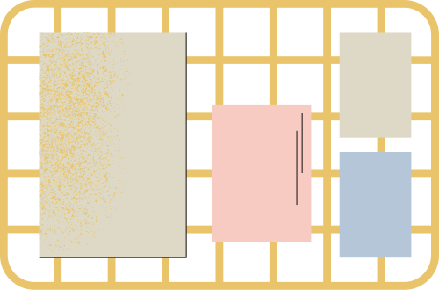
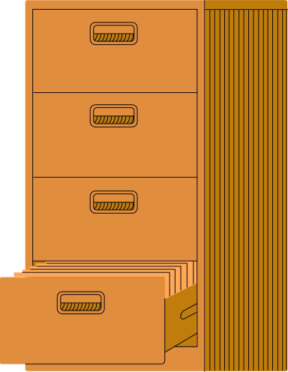
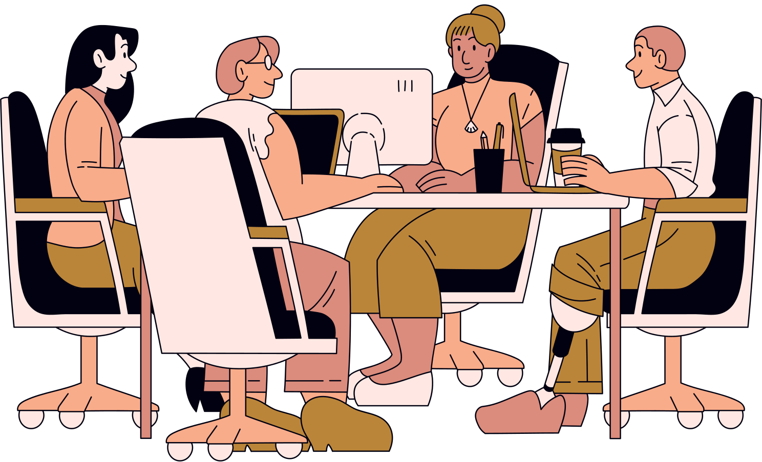

Just juan Journey
By Group 2A
| PinPin | Meredith | Ilhan | Yui Kuan | Xin Quan |

Slide 2

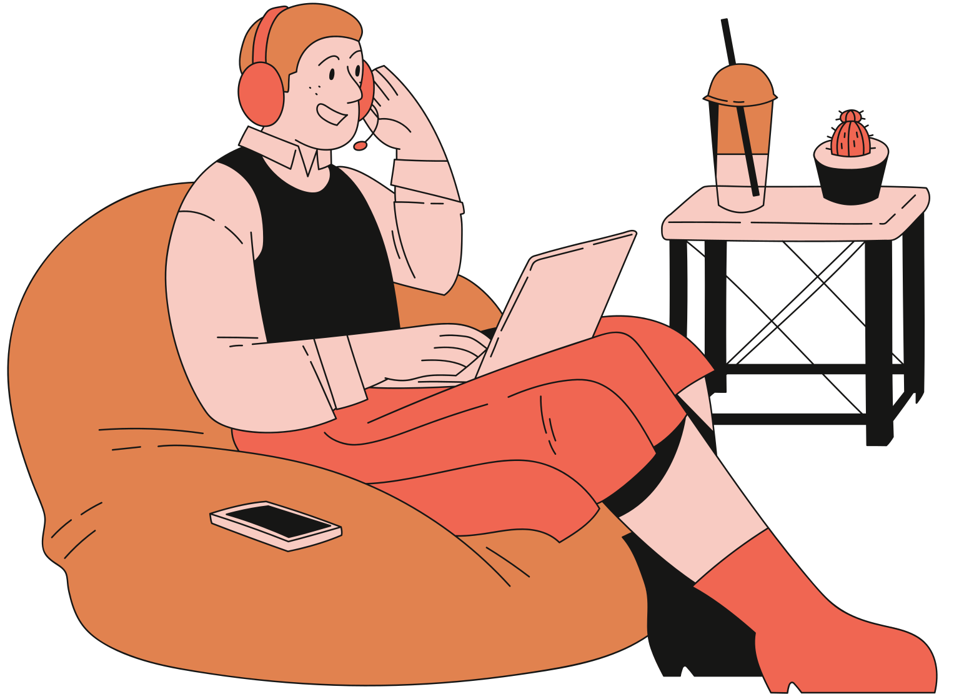
Table of Contents
Background
Sense & Sensibiliy
Ideation
Concept Strengthening Framework
Final Solutions & Prototypes
Co-Creation

Slide 3
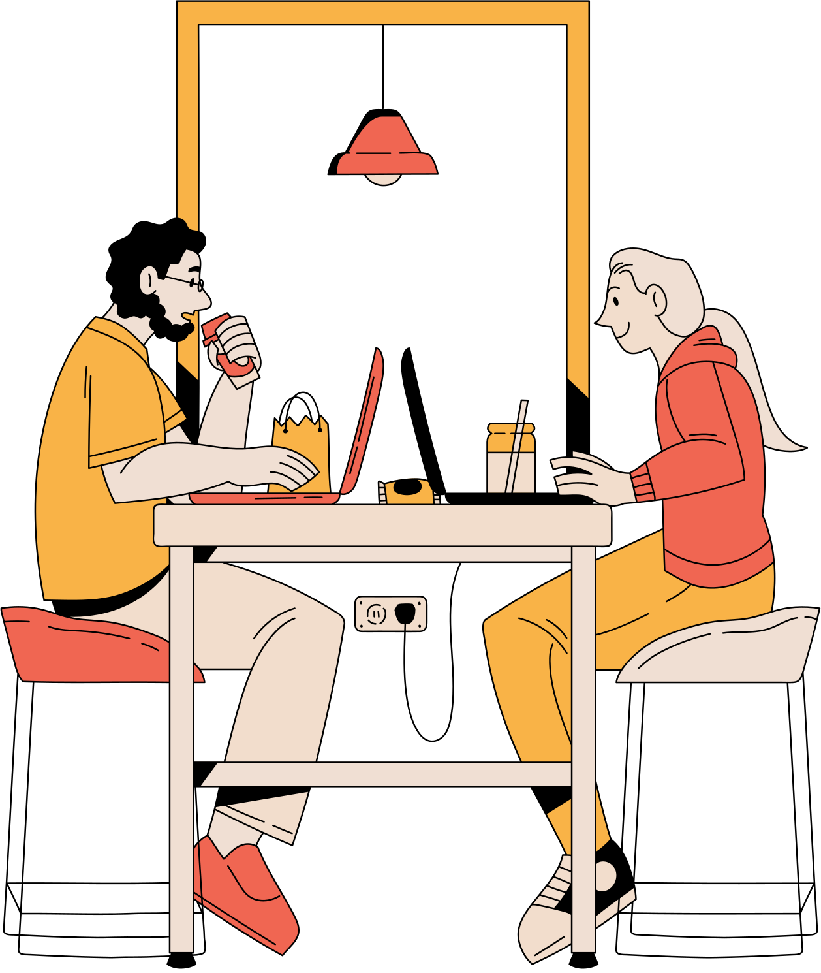
Background Information
PWDs often struggle in the workplace due to physical barriers, such as inaccessible facilities, as well as social challenges like discrimination and isolation

Slide 4
secondary research
In Batangas City, like many areas of the Philippines, the implementation of RA 10524 applies throughout the working environments.
RA 10524 mandates that at least 1% of all positions in government offices be reserved for PWDs.
However, it doesn’t apply to private sectors & the sectors would need at least 100 employees before the law takes place.

Slide 5
Sense & Sensibility
SPICE is used as a design thinking tool used to help us better understand the issues the user faces
Social
Physical
Identity
Communication
Emotional
PWDs face social barriers and stigma related to their disabilities, struggle with social interactions, and need support to secure employment.
PWDs' physical disabilities limit their mobility, and they need workplaces to be physically friendly and inclusive.
PWDs struggle with identity and self-perception & face discrimination in their workplace.
PWDs struggle to efficiently communicate with employers and coworkers to secure employment and facilitate teamwork.
PWDs feel lonely and ignored, and need support and encouragement to maintain a positive outlook.
1
2
3
4
5

Slide 6
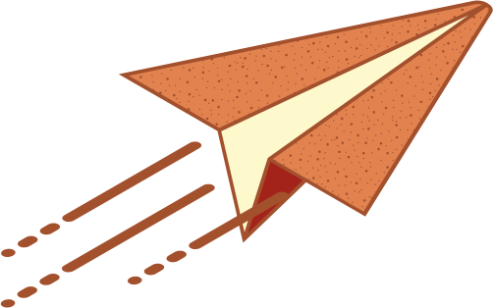

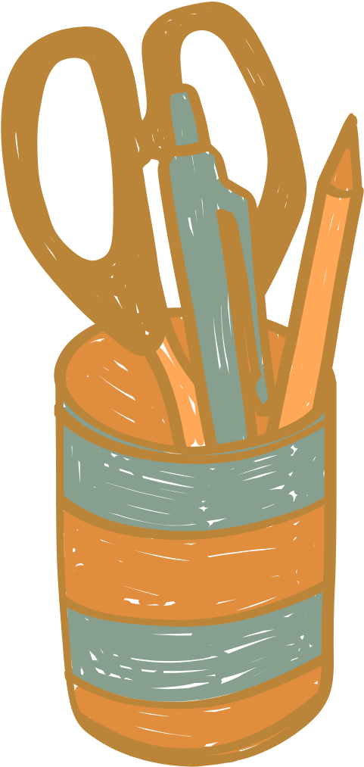

GENERATING INTERVIEW QUESTIONS
Close Ended
Open Ended
What is your age, gender, family size,
Marital status, & Occupation?
--------------------------------------------------
Do you encounter any problems
when traveling to work?
--------------------------------------------------
Are seeking out
any jobs lately?
--------------------------------------------------
How many years have you worked
in your current occupation?
--------------------------------------------------
When applying for a job, do you
prioritize salary, location, work environment?
Can you share more
about your disability
-----------------------------------------------
How has your experience been
communicating with your coworkers?
-----------------------------------------------
What adjustments have you made to adapt to your work environment based on your disability?
-----------------------------------------------
What problems do you face
when traveling to work?
-----------------------------------------------
What is your dream
job or ambition?

Slide 7
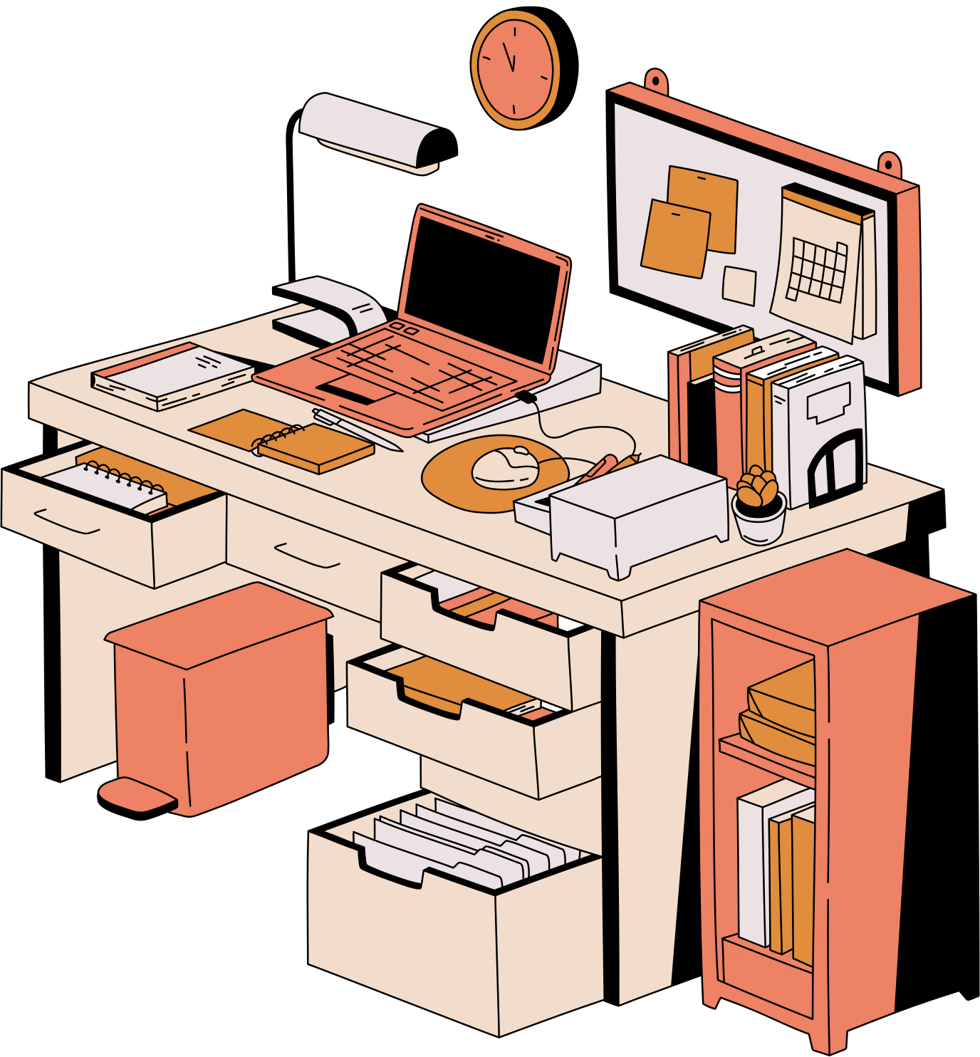
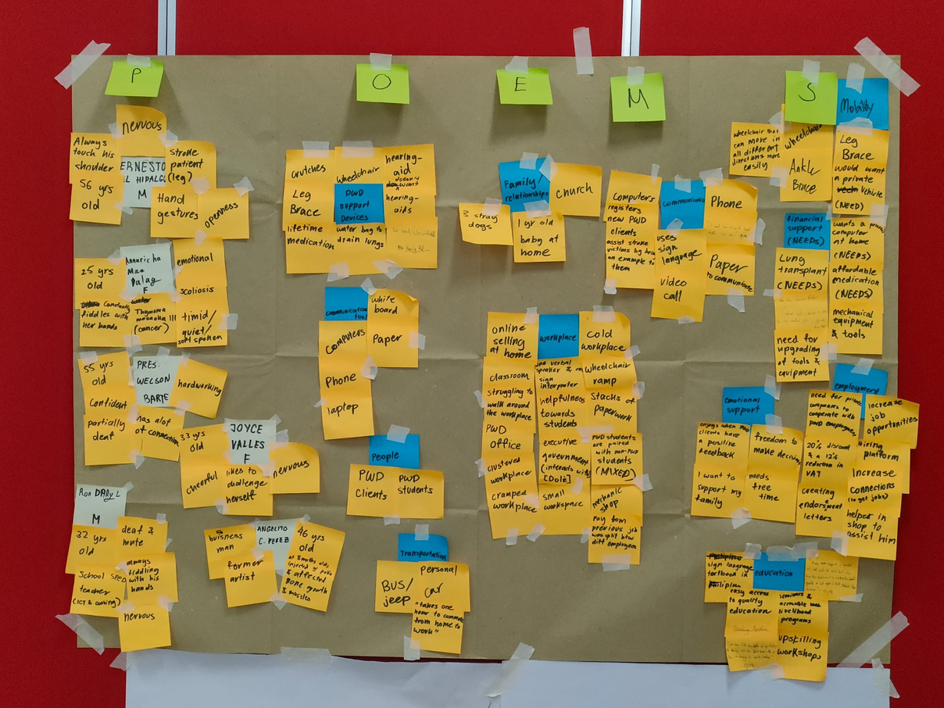
We grouped similar categorical answers to identify trends and seasonality.
DATA CLUSTERING
Eliminate excess information that does not need to be examined
Shift focus into important categories that give information and tell stories.

Slide 8
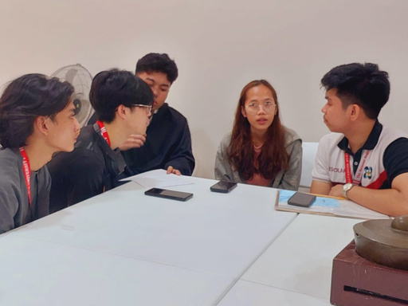
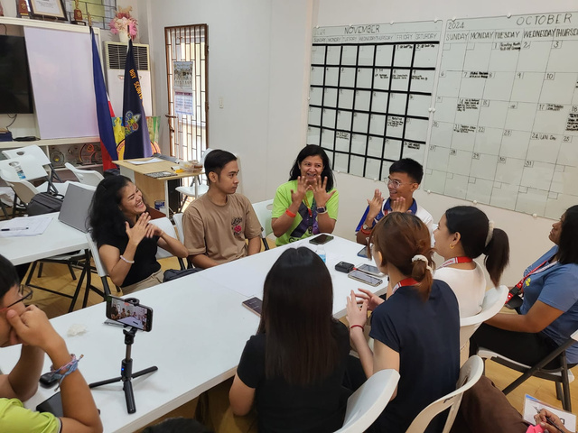
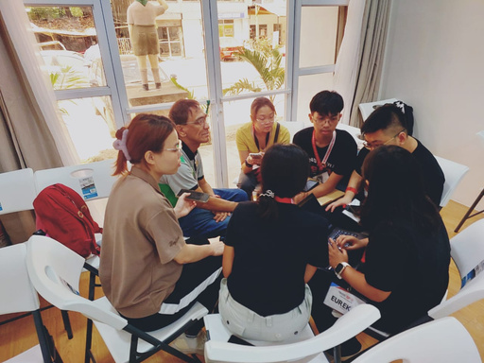
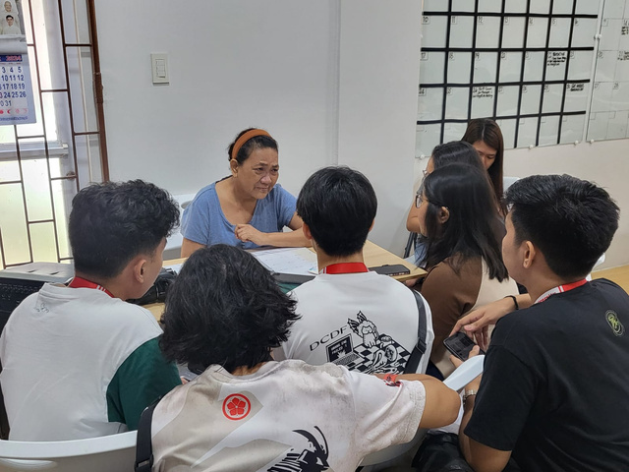
Descriptions of People we interviewed
Interviewees
(People)
Name | Condition | Description
Ernesto El Hidalgo | Stroke Patient | Leg braces Cheerful
Annuricha Mae Dalag | Cancer | Hardworking nervous
Pres Welson Barte | Muscular dystrophy (Lower body) | confident
Ron Daryl | Deaf & Mute | excited no ear-piece
Joyce Valles | Translator | happy
Angelito C. Perez | Polio | timid ankle braces

Slide 9
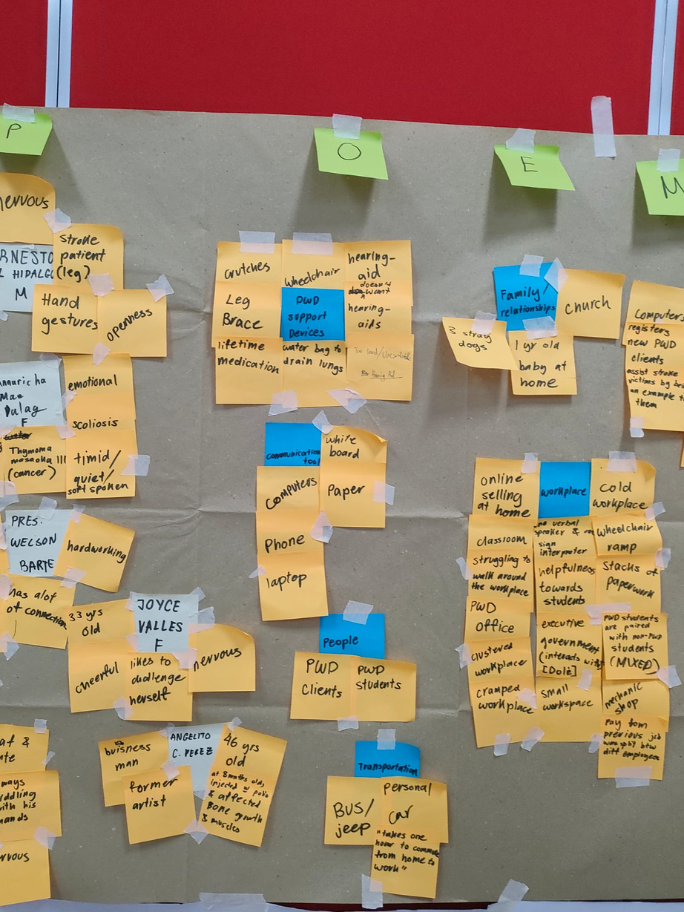
TYPE | DATA | INSIGHTS
PWDS SUPPORT DEVICES: | articles wheelchair hearing-aids leg brace lifetime medication water bags to drain lungs | “I feel like these support devices help me in gaining more independence.”
COMMUNICATION TOOLS: | whiteboard paper computers/laptops phone | “I find it difficult to make use of everyday basic items to ease communication and for work”
PEOPLE: | PWD clients PWD students | --
TRANSPORTATION: | bus/jeep personal car “takes an hour to commute from home to work” | “It is very tiring to travel to and from work due to long distance.”
Observation
(Objects)

Slide 10
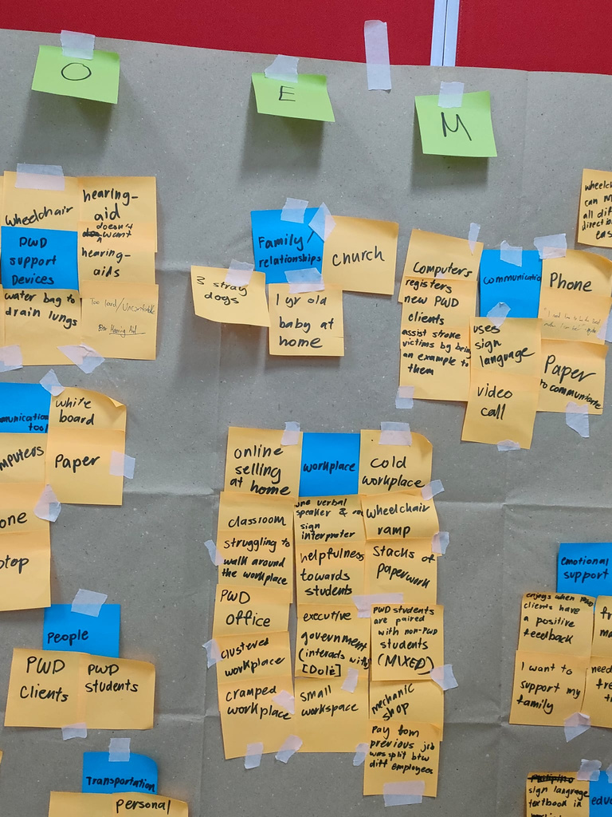
Observation
(environment)
TYPE | DATA | INSIGHTS
WORKPLACE | online selling at home cold workplace classroom PWD office cluster/cramped/small workplace executive government [dole] stacks of paperwork helpfulness towards students | --
FAMILY / RELATIONSHIPS | church 3 stray dogs 1 year old baby | “I have other responsibilities outside of work to worry, besides my disability.”

Slide 11
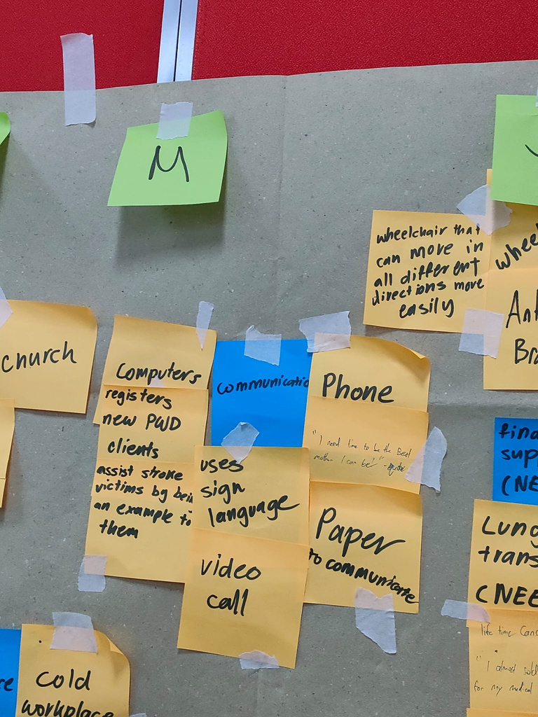
Observation
(MESSAGES)
TYPE | DATA | INSIGHTS
COMMUNICATION: | computers phone sign language video call paper to communicate | “I find it difficult to make use of everyday basic items to ease communication and for work”

Slide 12
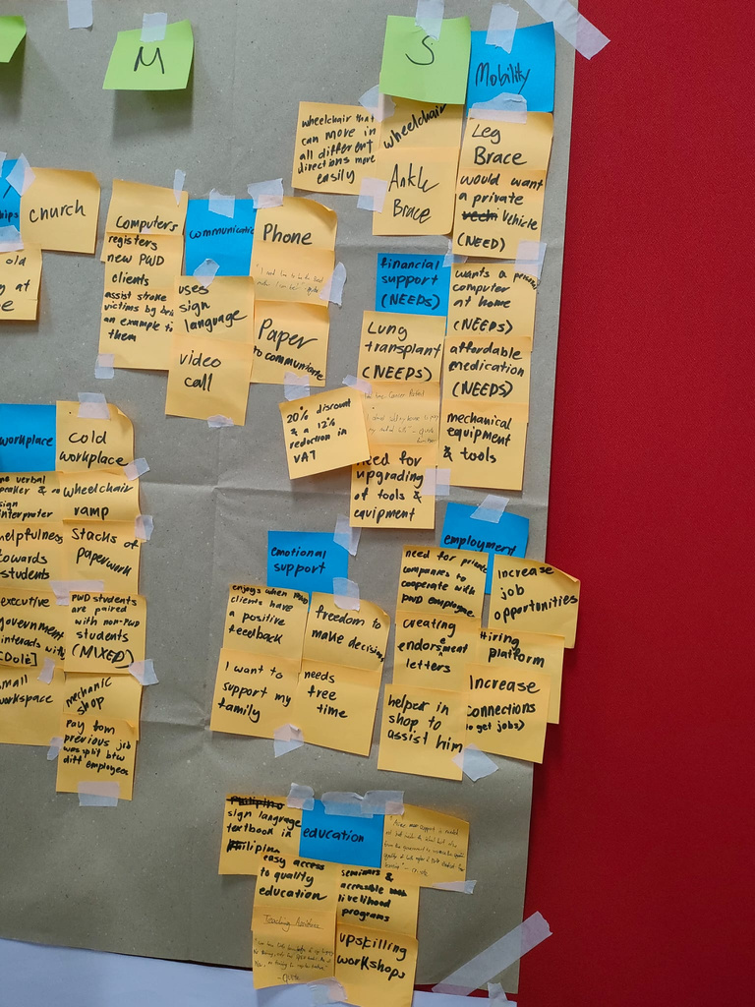
TYPE | DATA | INSIGHTS
MOBILITY: | ankle brace wheelchair would want a private wehicle wheelchair that can move in different directions more easily | “I find it hard to be independent as I would need to have support during my commutes to travel with ease.”
FINANCIAL SUPPORTS / NEEDS: | lung transplant wants a personal computer at home affordable medication mechanical equipement & tools need for upgrading of tools & equipments | “I feel like I struggle to fund for my daily needs.”
EMOTIONAL SUPPORTS: | freedom to make decision meeds free time “I want to support my family” “enjoys when PWD clients have a positive feedback” | --
EDUCATION: | upskilling workshops sign language textbook easy access to quality education | --
EMPLOYMENT: | increase job opportunities hiring platform creating endorsement letters helper in shop to assist him | “I feel like I don’t get too much opportunities to be employed due to lack of PWD friendly jobs.”
Observation
(SERVICES)

Slide 13
Our Inferred insights from clustering
Working Environment
Mobility
Communication
“I feel
like I don't get too many opportunities to be employed because of the lack of PWD-friendly jobs”
“I find
it hard to be independent as I would need to have support during my commutes to travel with ease”
“I find
it difficult to make use of everyday basic items to ease communication and for work”

Slide 14
The Needs statements
Working Environment
Mobility
Communication
“I need workplaces to have more physically friendly and inclusive environments for PWDs.”
“I need
an accessible approach to be independent when commuting to work alone.”
“I need
efficient communication with my potential employers to secure employment.”

Slide 15
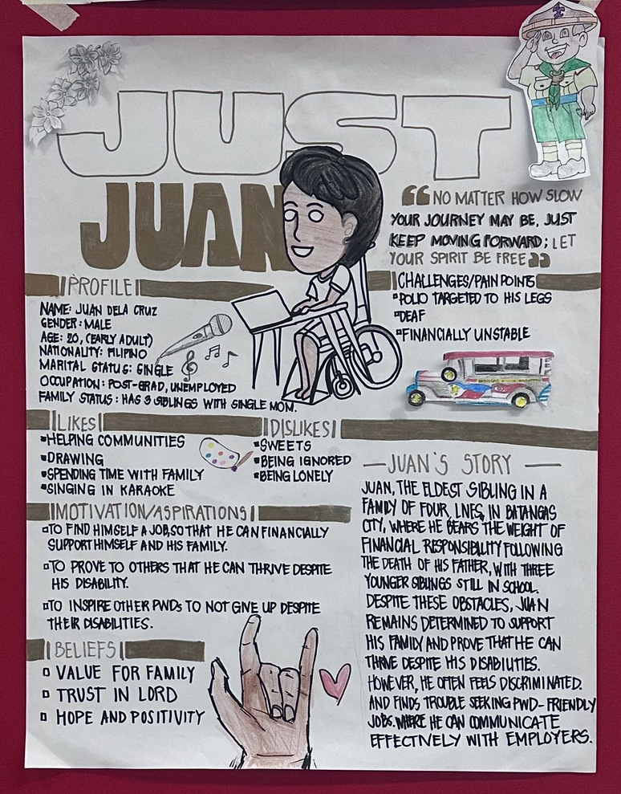
Our User Profile
Persona: Just Juan
| 20 years old |
| Post Graduate |
| Unemployed |
Quote
“No matter how slow your journey may be, just keep moving forward; Let your spirit be free!”
Likes
Helping the communities,
Drawing,
Singing in Karaoke
Dislikes
Sweets
Being Ignored
Being Lonely

Slide 16
Our User Profile
Motivation
To find himself a job, so that he can financially support himself and his family.
To prove to others that he can thrive despite his disability.
To inspire other PWDs to not give up despite their disabilities.
Beliefs
Value for Family
Trust in Lord
Hope and Positivity
Challenges
POLIO TRAGETED TO HIS LEGS
DEAF
FINANCIALLY UNSTABLE

Slide 17

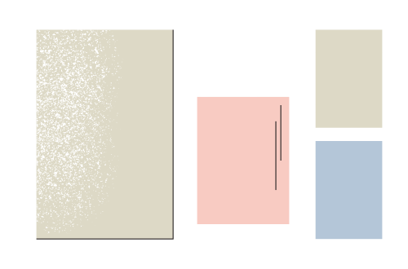

PROBLEM STATEMENT
“ HOW CAN WE PROVIDE INCLUSIVE WORKPLACES THAT HELPS PWDs TO BE MORE EFFICIENT AND PRODUCTIVE? ”

Slide 18
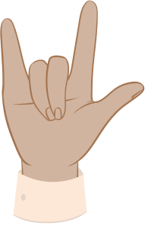

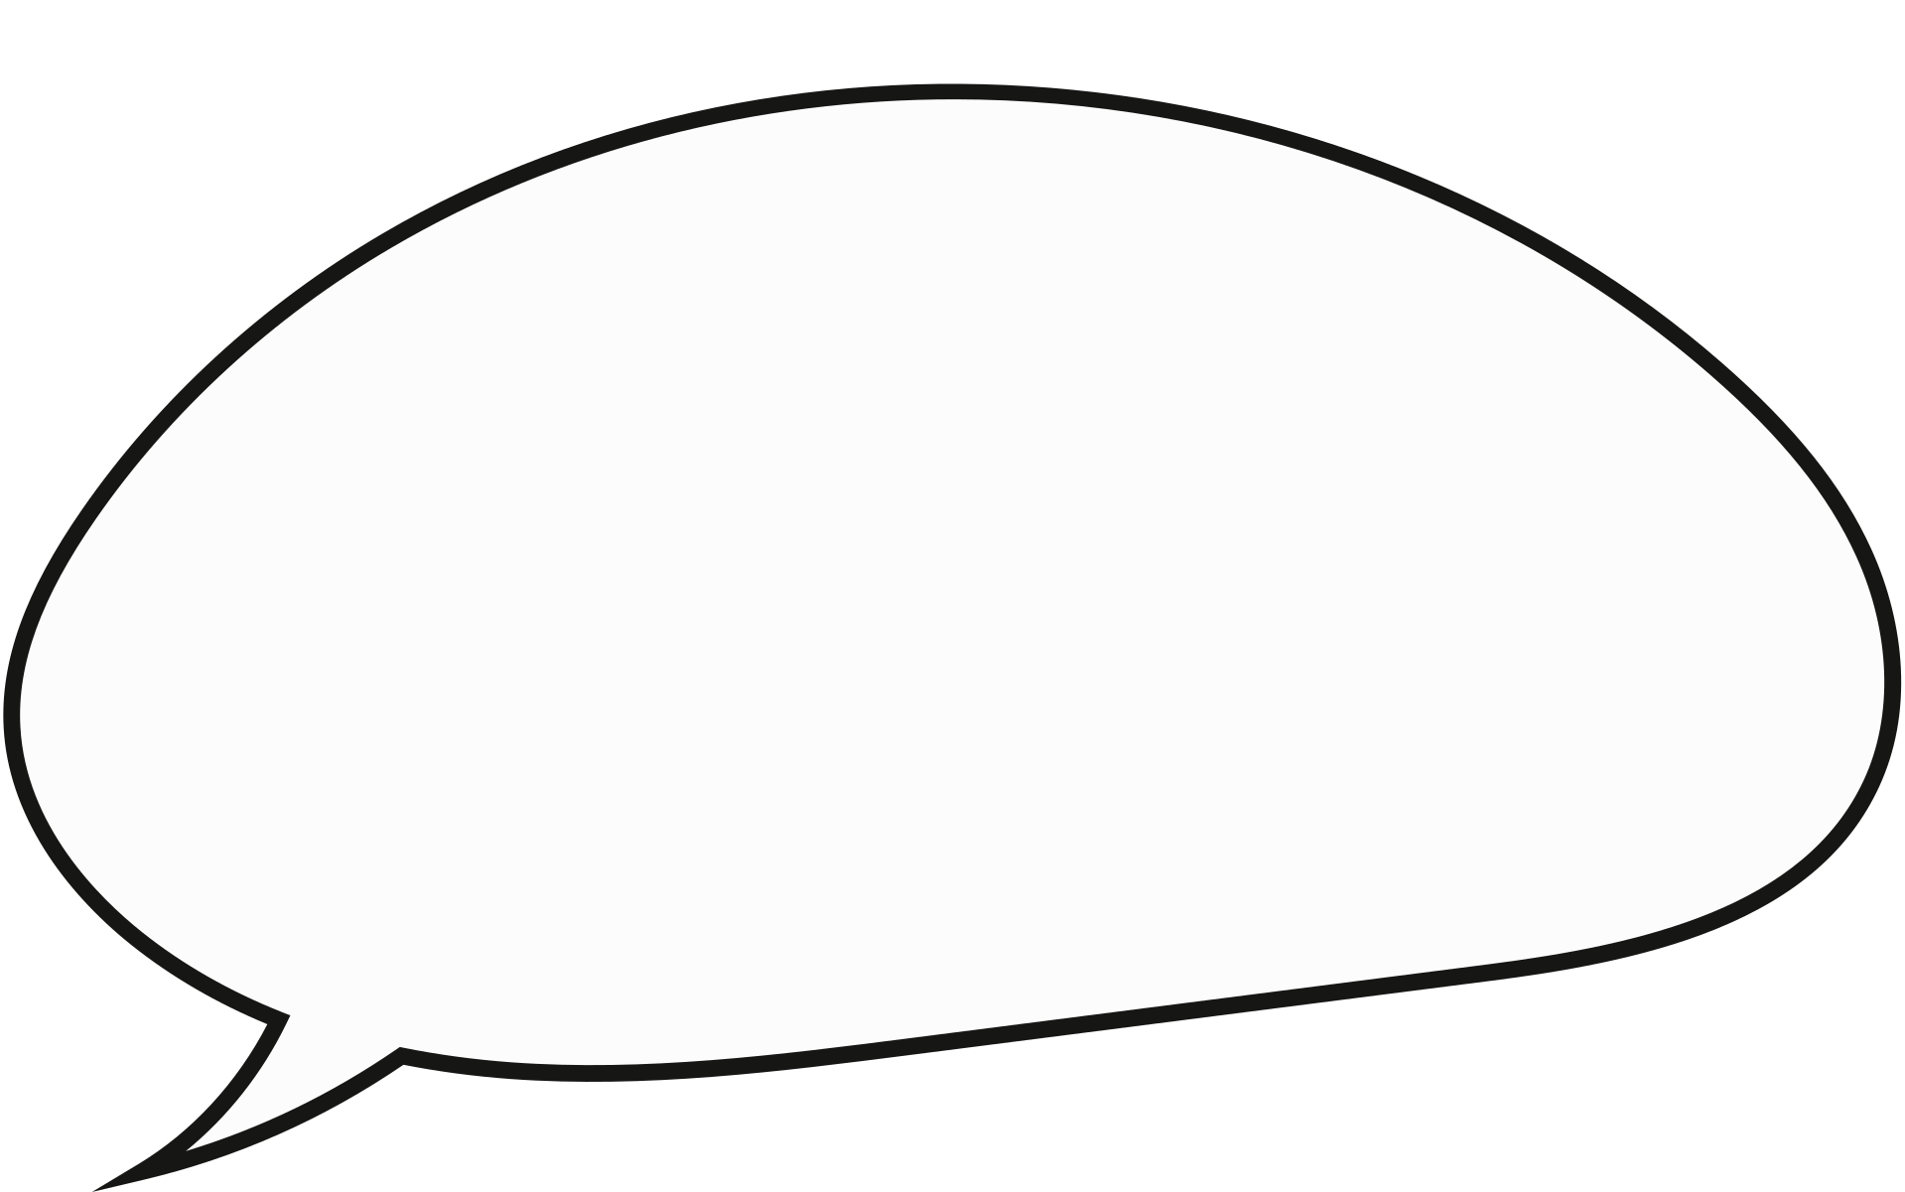


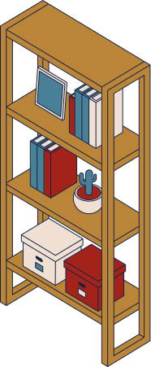

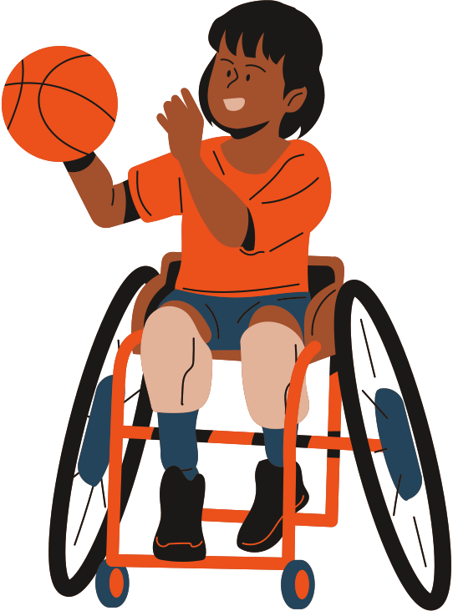

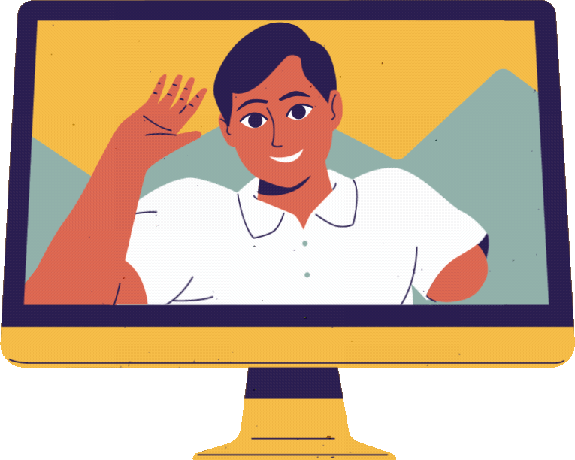

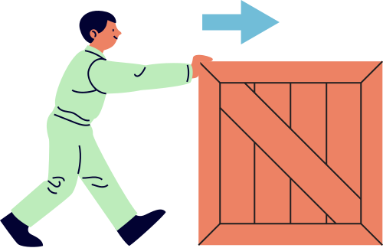
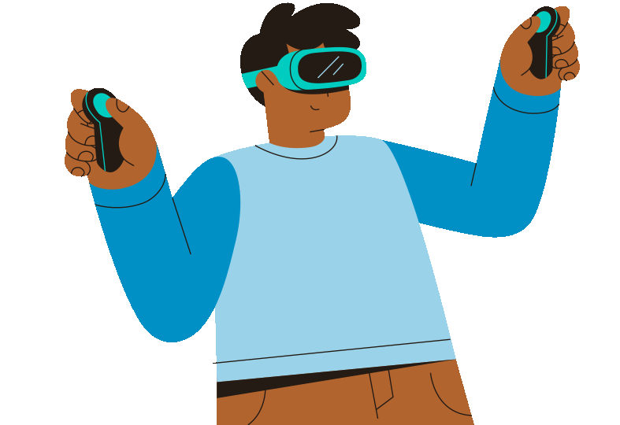
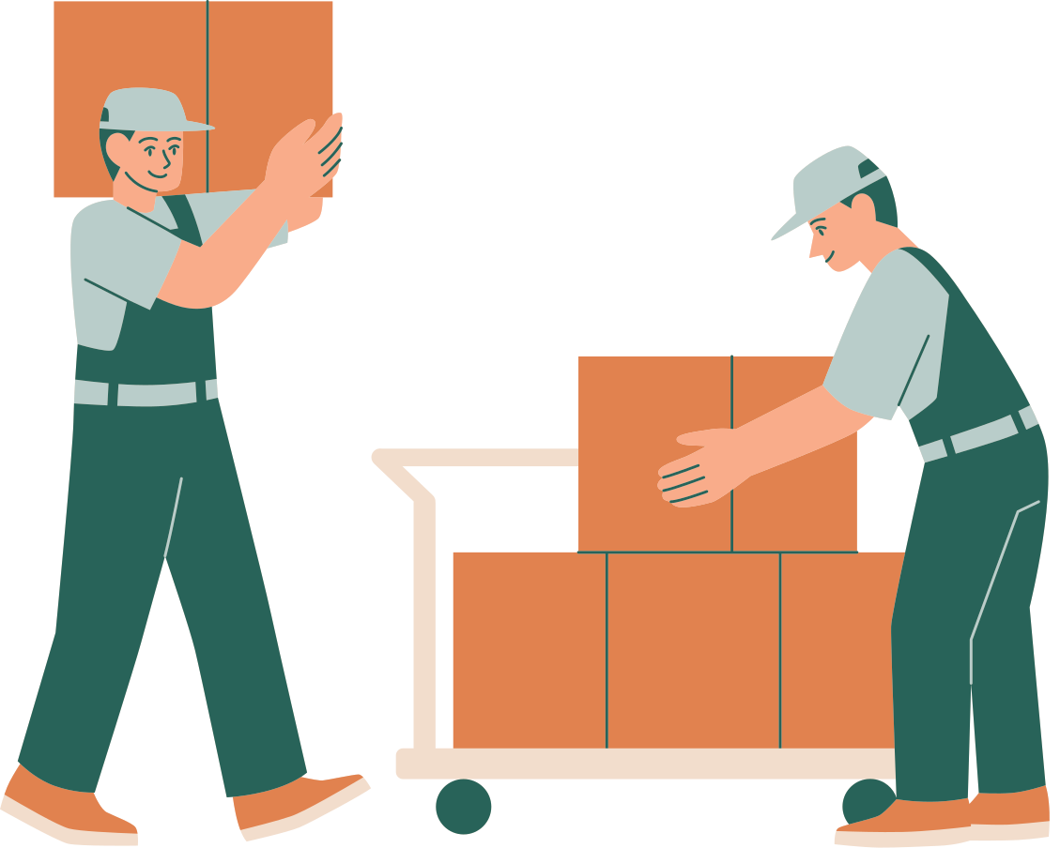

IDEATION (Brainstorming)
Move Aside!
Sign Language to Text Translator
Service Alert Button
Audio Alert Button
Automatic Braille Printer
Visual Alert LEDs
Multi-Directional Wheelchair
Speach to Text Translator
Text to Braille Translator
Coworker Alert Button
Stackable Table
Motion Sensor to Move Objects Away from PWDs
VR/AR Workplace Simulation
Automized PWD Work Environment
Automatic Shelving Compartments

Slide 19

SCAMPER FRAMEWORK
Move Aside!
Sign Language to Text Translator
SUBSTITUTE
COMBINE
ADAPT
MODIFY
PURPOSE
ELIMINATE
REVERSE
Service Alert Button
Audio Alert Button
Automatic Braille Printer
Visual Alert LEDs
Multi-Directional Wheelchair
Speach to Text Translator
Text to Braille Translator
Coworker Alert Button
Stackable Table
Automized PWD Work Environment
Motion Sensor to Move Objects Away from PWDs
VR/AR Workplace Simulation
Automatic Shelving Compartments

Slide 20
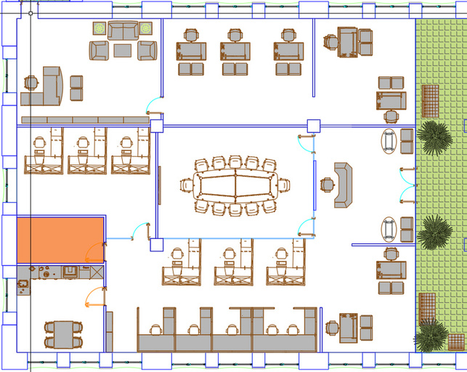
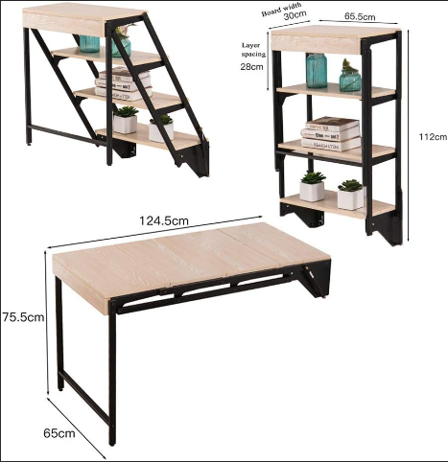
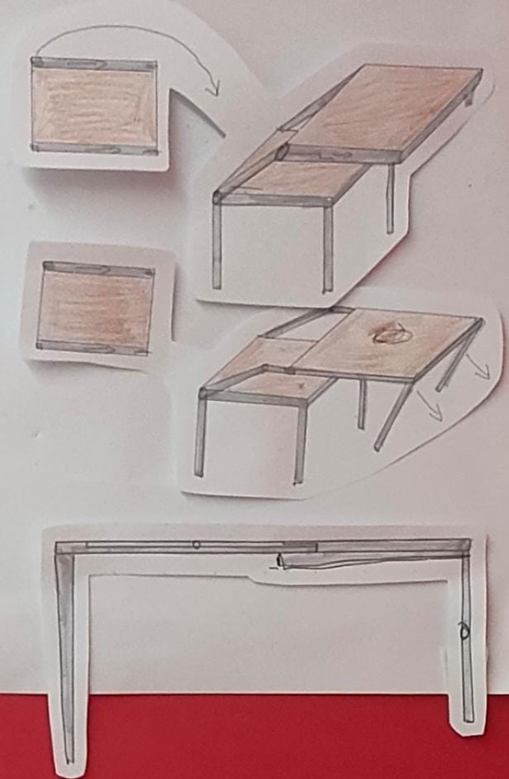
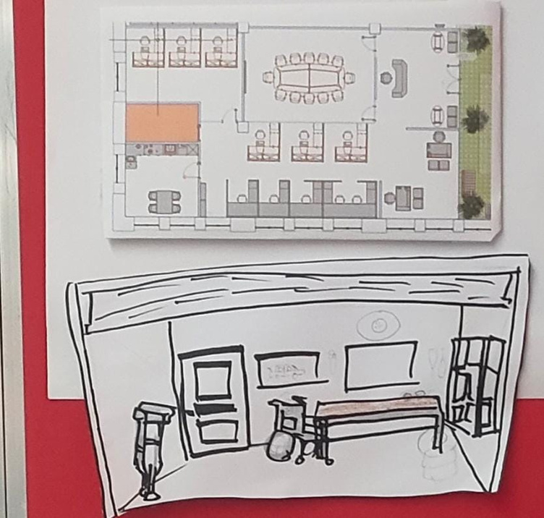
IDEATION (Concept Sketch)
FLOORPLAN FOR WORKPLACE
STACKIBLE
SHELF TO TABLE
IMPLEMENTATION DRAWING

Slide 21

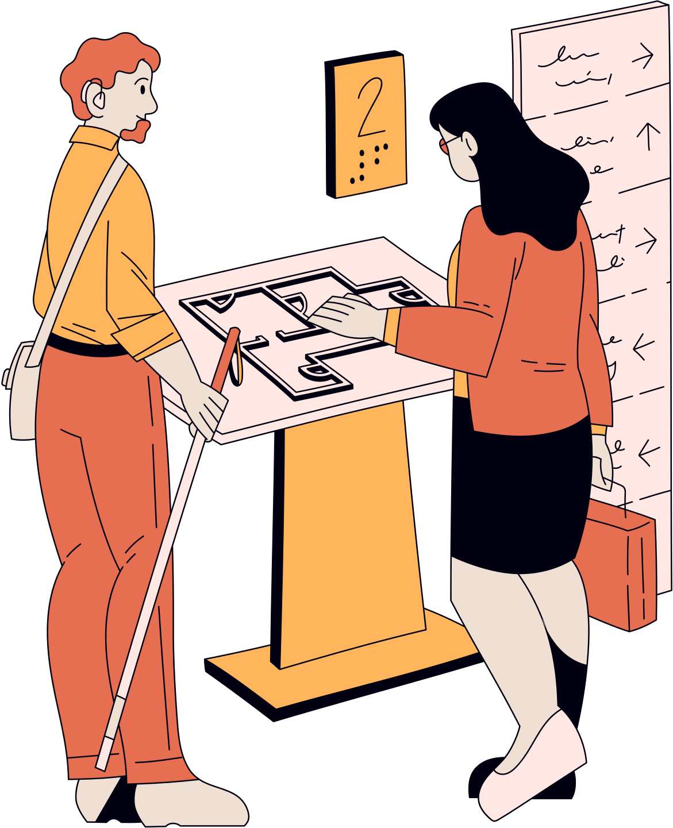
How our concept helps the persona?
Ensuring an inclusive workplace that helps PWDs to be more efficient and productive with whichever work they are employed in.
What are the features of this concept?
Floor Plan
railing in toilet
Tables and Storage
Ramps
Retractable worktable
Speech to text
Alert system
Automatic movement
Alert
Website
Add co-worker
alert co-worker
Message co-worker

Slide 22
HOW THE SOLUTION MEETS THE USER’S NEEDS?
Enhanced Mobility
Ease of Use for PWDs
Promoting Independence
Space for Movement
Retractable extension creates a clear pathway for easy mobility.
Comfortable
Design
Ample legroom allows users sit comfortably.
Simple Operation
The automated lifting mechanism lets users stack the table upwards with a push of a button.
Intuitive Controls
A user-friendly panel ensures accessibility for all.
Self-Sufficiency
Users can manage their setup independently, boosting confidence.
Versatile Functionality
Doubles as a shelving unit when retracted for added storage.

Slide 23






concept
STRENGTHENING
value proposition of solution
framework
JOB SATISFACTION AND PRODUCTIVITY
LIMITATIONS
IMPACTS/ USER EXPERIENCES
PWDs WOULD BE ABLE TO:
MOVE AROUND THE WORKPLACE COMFORTABLY
BE NOTIFIED WHEN COWORKERS NEED THEIR ATTENTION
HAVE INCREASED INDEPENDENCE AND EASE IN PERFORMING TASKS
FIND COMFORT WITH THE LIMITED SPACE
FEEL BETTER INCLUSIVITY
FEEL BETTER
VALUE
resources/infrastructure
PROTOTYPE (TABLE)
FINAL OUTPUT (table)
FINAL OUTPUT (FLOOR PLAN)
CARDBOARD
PAPER
STRING
ARDUINO SYSTEM
PLYWOOD
STAINLESS STEEL HINGES
BUTTONS
MICROPROCESSOR
PWD OFFICE
MECHANIC WORKSHOP
GENERAL OFFICES

Slide 24
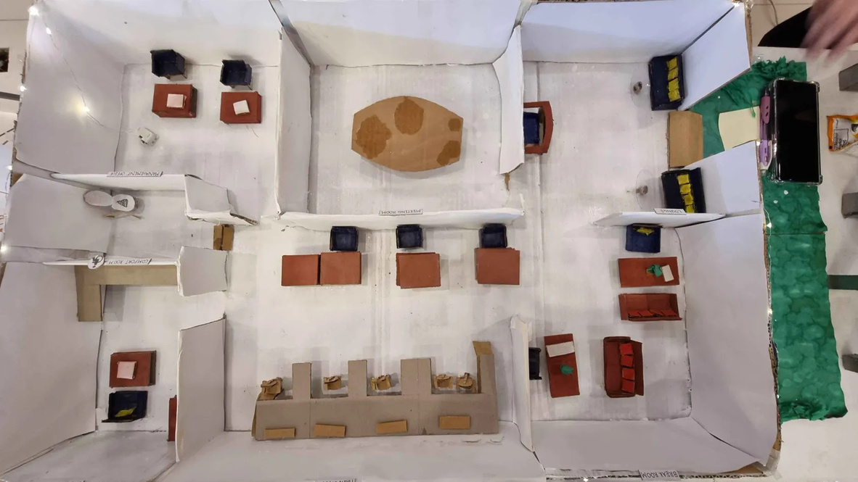
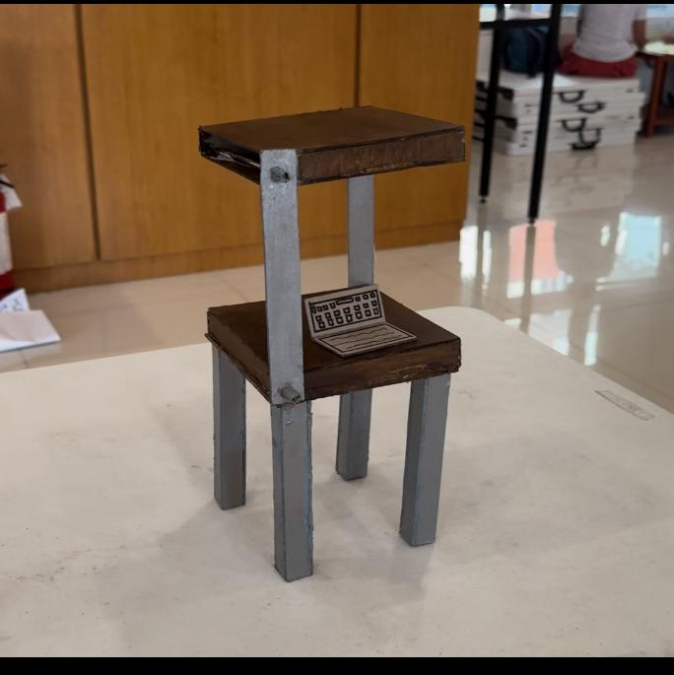
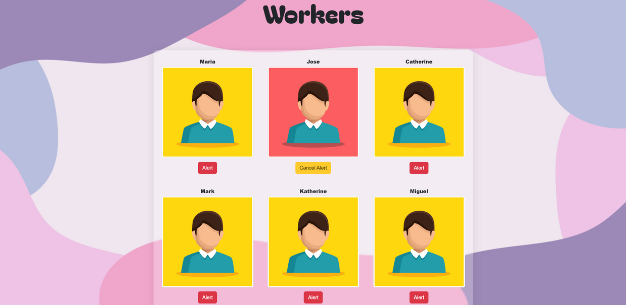
solution 1.0
Floor Plan Of The Office
Alert Website
STACKIBLE

Slide 25
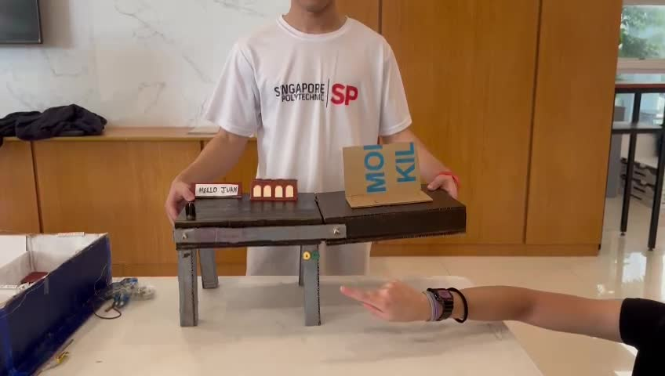
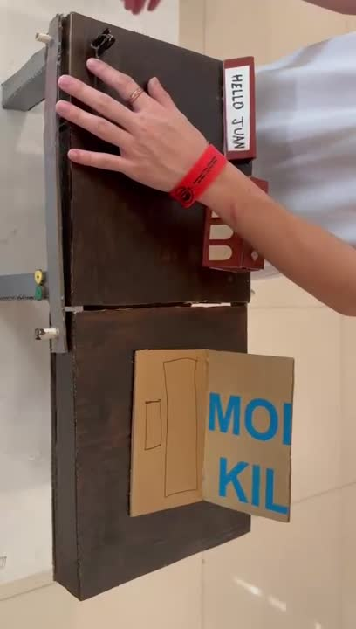
Prototype
1.
Buttons to allow the table to transform and stack onto each platform
2.
Push-To-Talk microphone for co-workers
3.
Speech-To-Text translator to cater to people with impaired hearing
4.
Screen that works hand-in-hand with the S-T-T translator to allow easier communication between colleagues.
5.
Stackible
Inclusive design for PWDs

Slide 26
Prototype
1.
Showcases exemplary workplace design inclusive for PWDs
2.
Allows for easier movement for PWDs around the workplace
3.
Accessible physical spaces eg: Ramps, Signages, large doors, restrooms, etc
Floor plan Of The Office
4.
Joint spaces between coworkers and PWDs

Slide 27
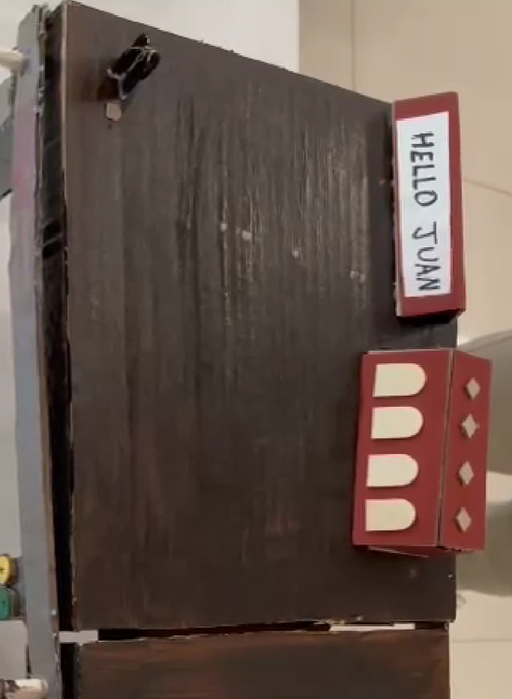
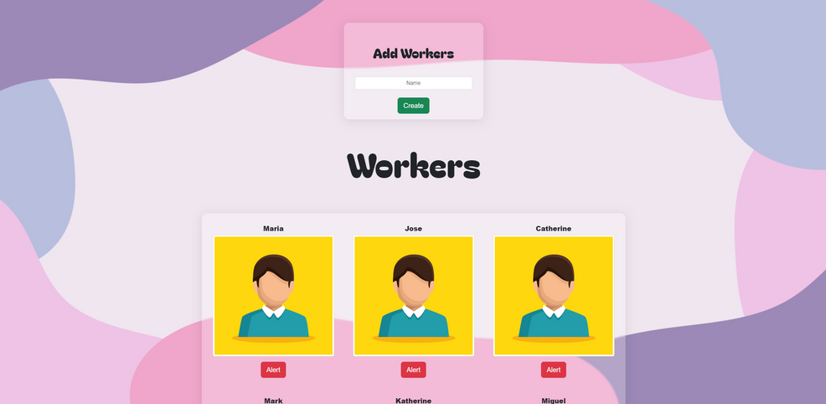
Prototype
1.
Alert employees/co-workers
2.
Able to add new workers
3.
Scalable for workplaces with high coworkers
Alert website

Slide 28
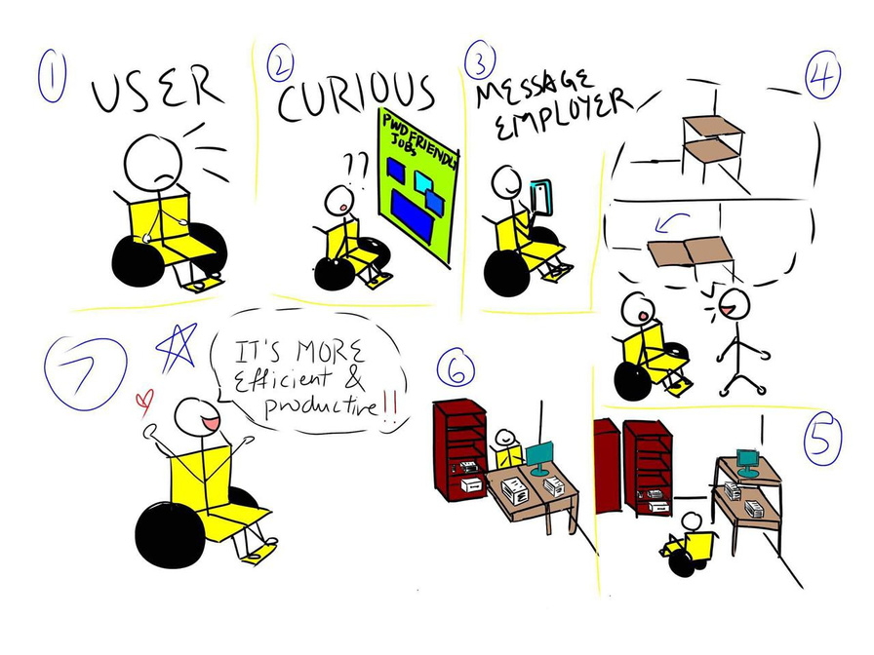
USER JOURNEY MAP
FIRST CONTACT
He stumbles across a post consisting of compiled jobs that have a PWD FRIENDLY ENVIRONMENT , highlighting innovative & inclusive designs.
KNOWLEDGE
He messaged the employer for a look around one of the jobs located in an office environment in the room, he came across the product and was taught the various benefits & functions of the product.
ACTION
Our product is meant to be able to stack on top of each platform of the table with a click of a button. It can also unstack with a click of the button.
FIRST USE
To maneuver into the desk place with his wheelchair, he can choose to extend or decrease the length of the table.
ONGOING USE
He remembers how convenient & easy it is to work around the desk as he has more than enough space to work with due to the inclusive design of the table.

Slide 29

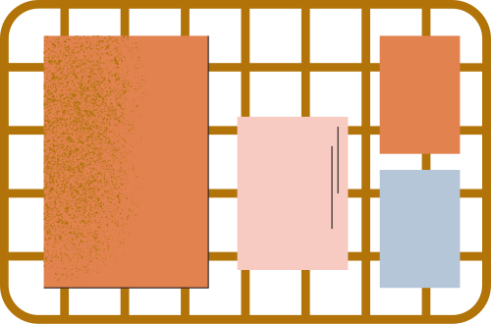
ENSURING SUSTAINABILITY
& CONTINUATION

Slide 30


ENSURING SUSTAINABILITY & CONTINUATION UNSDGs
Goal 8
Goal 11
SDG 8.5 : Achieving Full & Productive Employment & Decent Work For All Individuals
Designing accessible furniture contributes to making the workplace more inclusive, thus fostering sustainable communities that accommodate all individuals.
Full & Productive Employment
Inclusivity
Equal Pay
The table can promote full and productive employment for PWDs by the providing them with a functional workplace, which contributes to the economic growth and reducing unemployment .

Slide 31
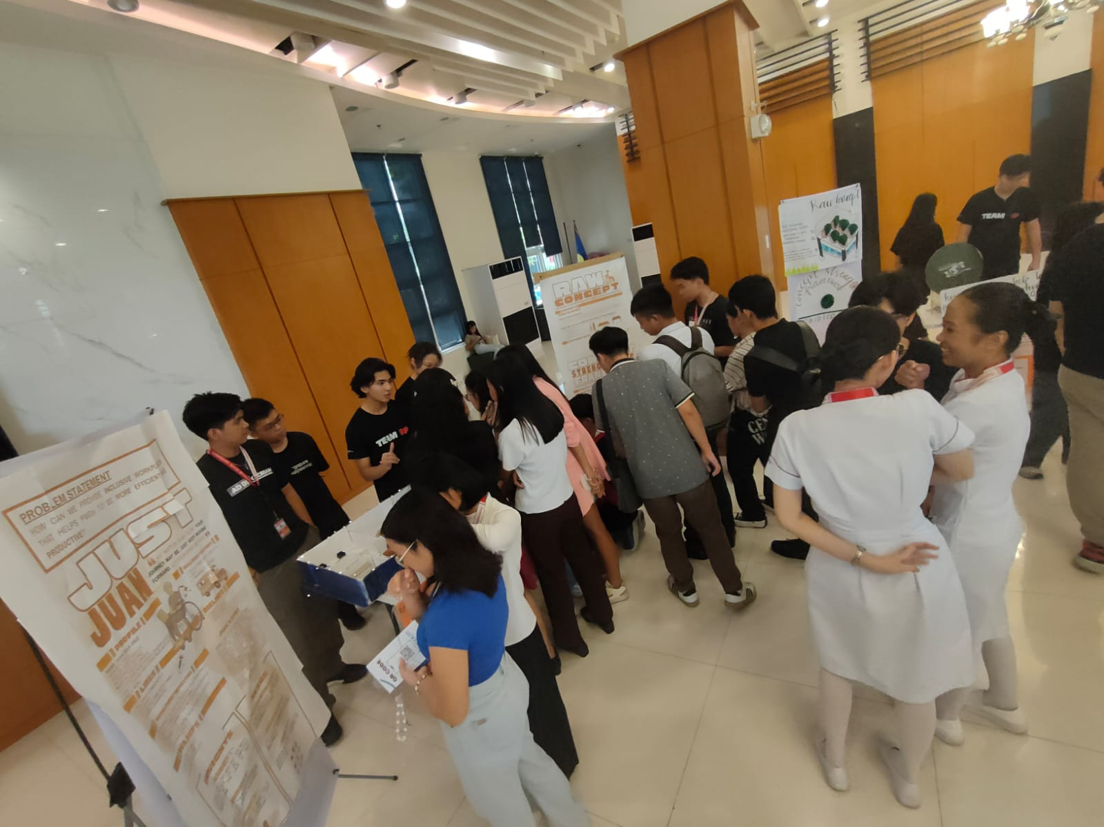
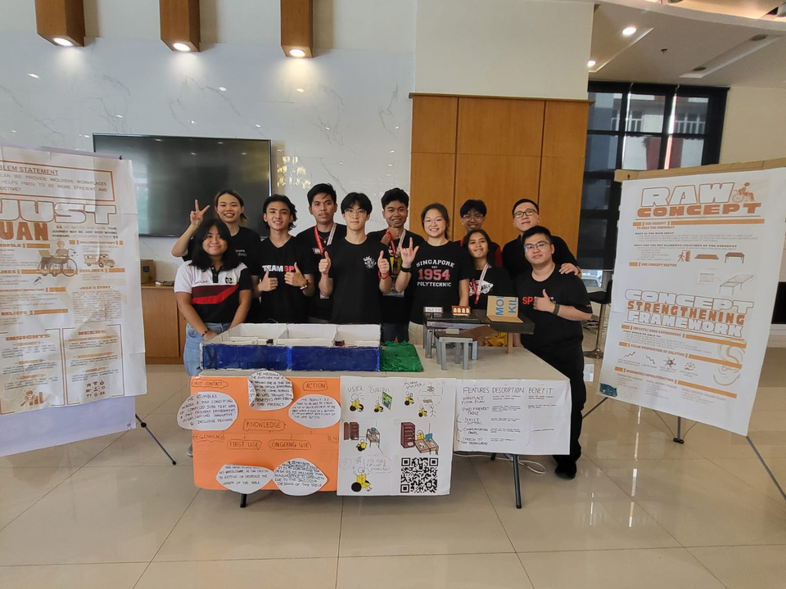
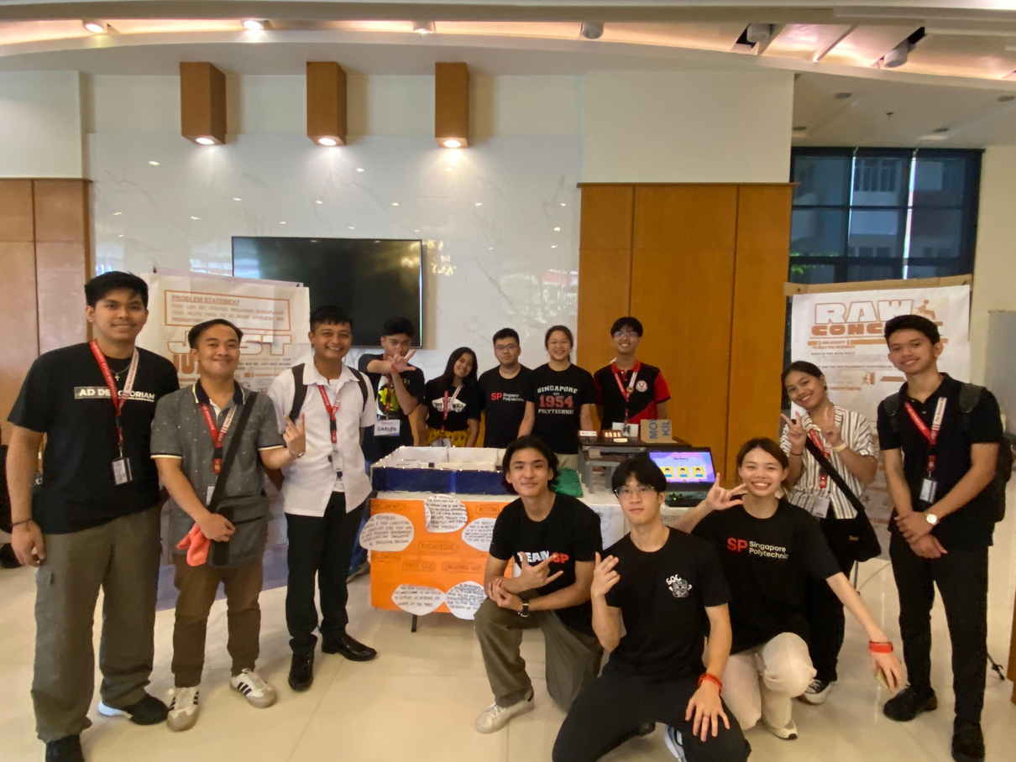
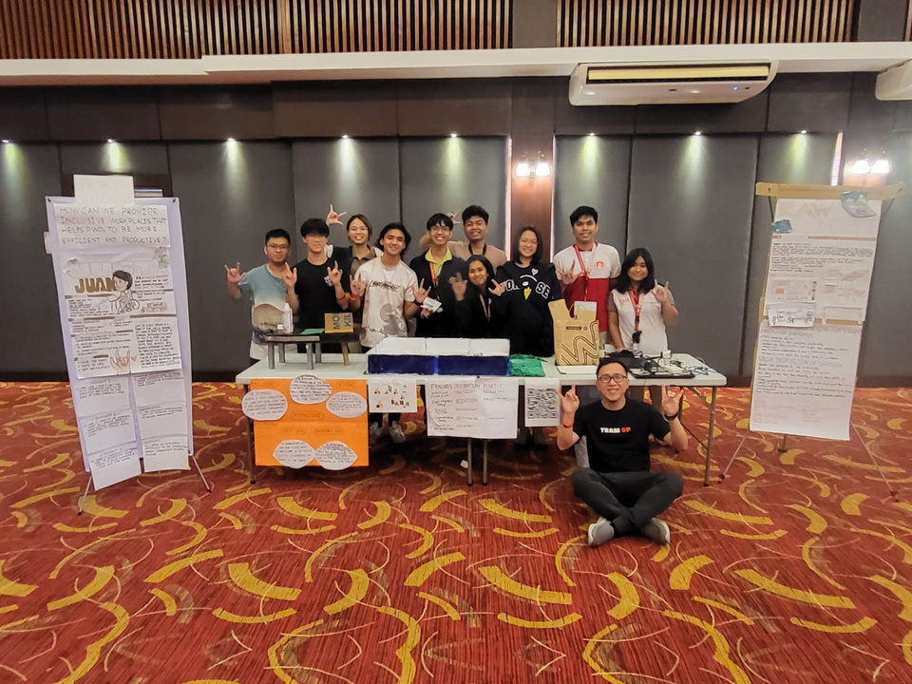
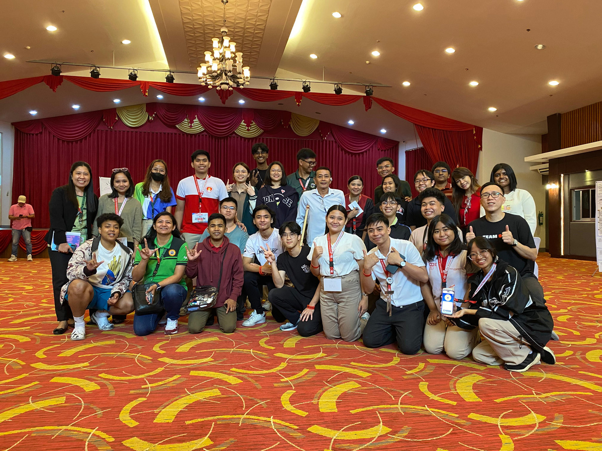
GALLERY WALK

Slide 32
user feedback (Stackible)
Positive
Negative
1.
1.
Good Concept to save space in cramped workplaces
Materials to build the table will be very costly
2.
2.
Very time saving & efficient as users won’t need to clear the table before stacking
Speech to text too slow
3.
3.
It doesn’t cater towards the blind
Good that we applied the Accessibility Law (Batas Pambansa Bilang 344) for the pwd
4.
Speech to text hard to detect tagalog accent

Slide 33
user feedback (floor plan)
Positive
Negative
1.
1.
Great way of explain how to use our product
Floor plan too basic.
Needs more detail!!
2.
Good that we had small details like railings & ramps

Slide 34
user feedback (Website)
Positive
Negative
1.
1.
Good Concept for scalability
Costly because we need a computer to run the server.
2.
Looks clean & easy to navigate.
Great for pwd!

Slide 35
Gallery walk (FAQ)
Question
Answer
1.
1.
How long does the table take to stack?
We are trying to find an in-between of 4 sec!
2.
2.
We are aiming to have around 40 KG. We need stronger materials!
What is the weight limit of the stacked table
3.
3.
Can it cater towards the blind too?
We plan to have a brail for the button & buzzing motor when alerting the blind PWD!
4.
4.
Is there a safety feature as the table opens up?
YES! we are implementing a distance sensor in case someone is in the way of opening.

Slide 36
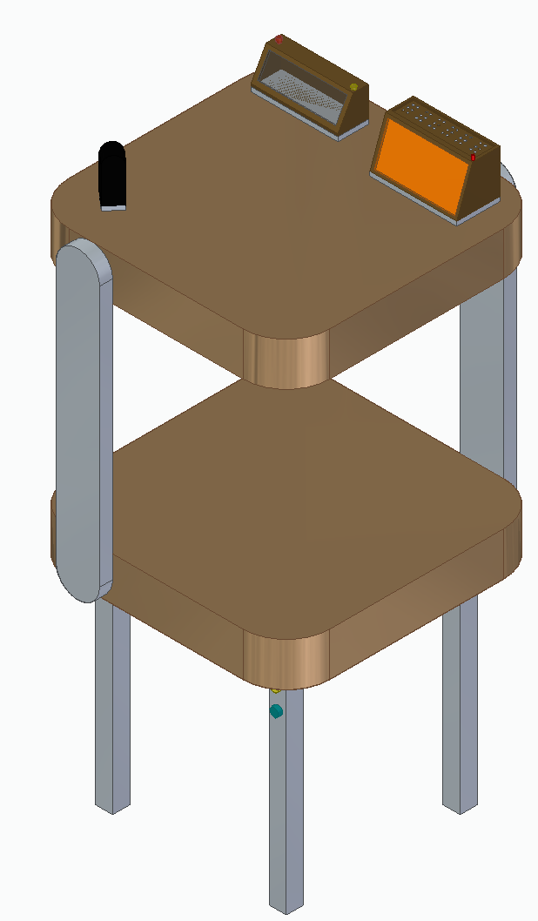
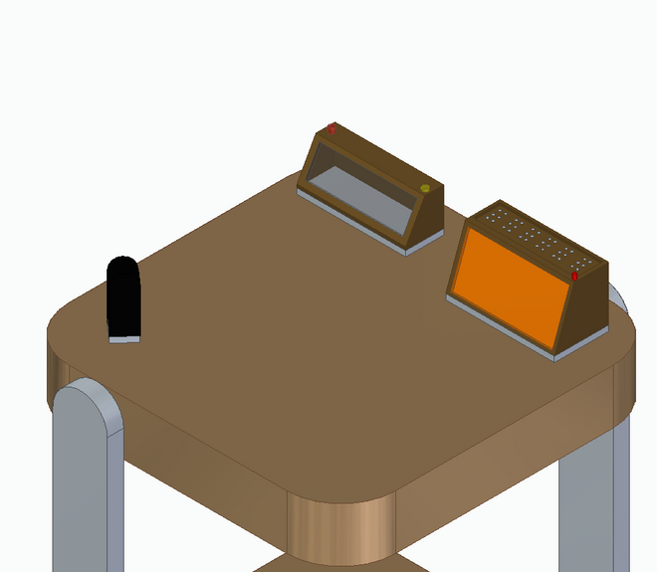
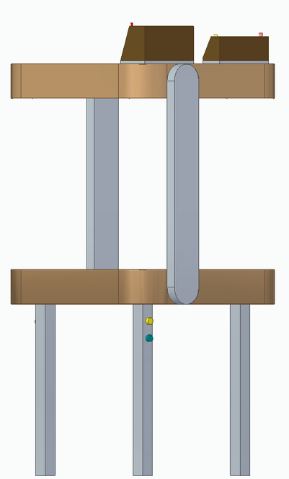
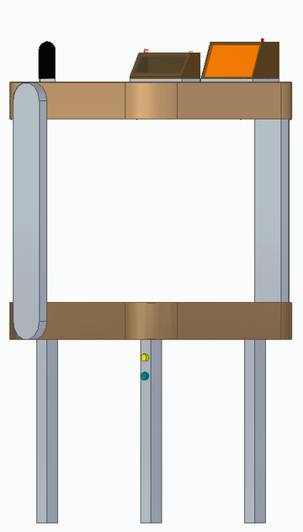

Front
Back
FUTURE EXPANSIONS
Improvements
Rounded Corners
Pop up Buttons (Braille)
Stop Safety Detector

Slide 37




THANK
YOU!

